Slide 1
Molecular Classification of Cancer
Class Discovery and Class Prediction by Gene Expression Monitoring
T. R. Golub, D. K. Slonim & Others
1999

Slide 2
Big Picture in 1999
The Need for Cancer Classification
  Cancer classification very important for advances in cancer treatment.
  Cancers of Identical grade can have widely variable clinical courses
Focus on improving cancer treatment by:
  Targeting specific therapies to pathogenetically distinct tumor types
  To maximize efficacy
  To minimize toxicity

Slide 3
Big Picture in 1999
Cancer classification based on:
  Morphological appearance.
  Enzyme-based histochemical analyses.
  Immunophenotyping.
  Cytogenetic analysis.
Methods had serious limitations:
  Tumors with similar histopathological appearance can follow significantly different clinical courses and show different responses to therapy
  Some of these differences have been explained by dividing tumors into sub-classes
  In other tumors, important sub-classes may exist but are yet to be defined
Classification historically relied on specific biological insights

Slide 4
Executive Summary
A generic approach to cancer classification based on Gene Expression Monitoring by DNA microarrays
Applied to human Acute Leukemias as a test case
A Class Discovery procedure automatically discovered the distinction between AML and ALL without prior knowledge.
An automatically derived Class Predictor to determine the class of new leukemia cases.
Bottom-line: A general strategy for discovering and predicting cancer classes for other types of cancer, independent of previous biological knowledge.

Slide 5
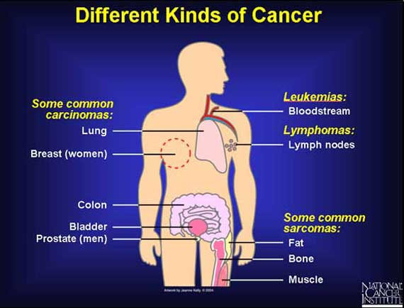
Types of Cancer

Slide 6
Leukemia
Leukemia is Cancer of the Blood or Bone Marrow
Characterized by abnormal production of WBC in the body

Slide 7
Classification of Leukemia
Acute vs Chronic
  Chronic: The abnormal cells are more mature (look more like normal white blood cells)
  Acute: Abnormal cells are immature (look more like stem cells).
Myelogenous vs Lymphocytic
  Myelogenous: Leukemias that start in early forms of myeloid cells
  Lymphocytic: Leukemias that start in immature forms of lymphocytes

Slide 8
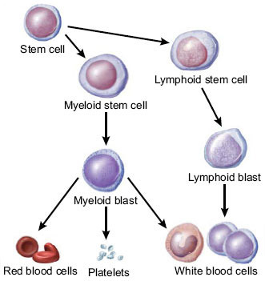
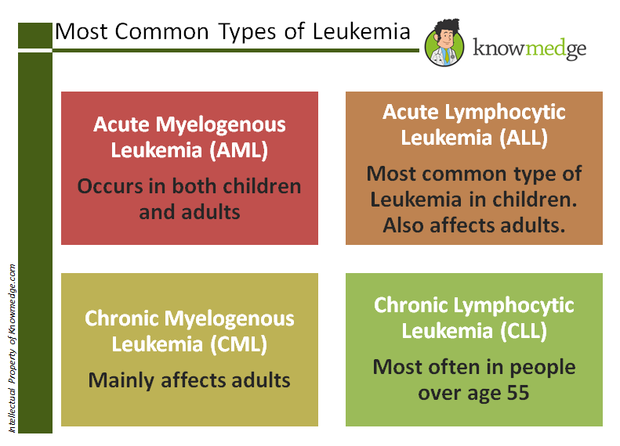
Classification of Leukemia

Slide 9
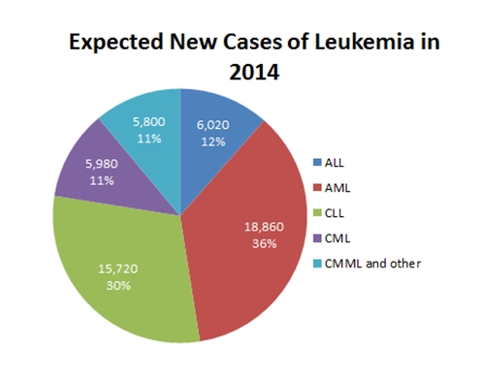
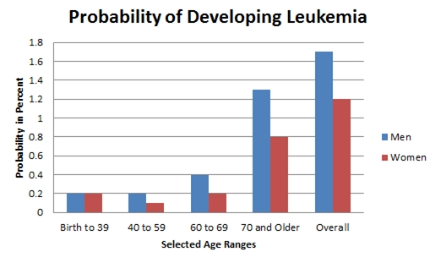
Some Statistics on Leukemia

Slide 10
More Background on Leukemia
In 1999, no single test is sufficient to establish the diagnosis
A combination of different tests in morphology, histochemistry and immunophenotyping used.
Although usually accurate, leukemia classification remains imperfect and errors do occur

Slide 11
Problem
How do we categorize different types of Cancer so that we can increase effectiveness of treatments and decrease toxicity?
Motivation
No general approach for identifying new cancer classes (Class Discovery) or for assigning tumors to known classes (Class Prediction).

Slide 12
Objective
Idea / Intuition
Cancers can be automatically classified based on Gene Expression.
To develop a more systematic approach to cancer classification based on the simultaneous expression monitoring of thousands of genes using DNA microarrays with leukemia as test cases.

Slide 13
Gene Expression Monitoring
Gene Expression
  Process by which information from a gene is used in the synthesis of a functional gene product.
  Products are typically proteins
  In tRNA or snRNA genes, the product is a functional RNA.

Slide 14
Problem Breakdown
Class Prediction: Assignment of particular tumor samples to already-defined classes (supervised learning).
Class Discovery: Defining previously unrecognized tumor subtypes. (unsupervised learning).

Slide 15
Class Prediction
How can we use an initial collection of samples belonging to known classes to create a class Predictor?
  Issue-1: Are there genes whose expression pattern are strongly correlated with the class distinction to be predicted?
  Issue-2: How do we use a collection of known samples to create a “class predictor” capable of assigning a new sample to one of two classes?
  Issue-3: How do we test the validity of these class predictors?

Slide 16
Data: Biological Samples
Primary samples:
  38 bone marrow samples (27 ALL, 11 AML)
  obtained from acute leukemia patients at diagnosis
Independent samples:
  34 leukemia samples (24 bone marrow, 10 peripheral blood samples)

Slide 17
Process: Use DNA Microarrays
MicroArrays contained probes for 6817 human genes
RNA prepared from cells was hybridized to high-density oligonucleotide MA
Samples were subjected to a priori quality control standards regarding the amount of labeled RNA and the quality of the scanned microarray image.
About DNA Microarrays
  Also known as DNA chip or biochip
  Collection of microscopic DNA spots attached to a solid surface.
  Used to measure the expression levels of large numbers of genes simultaneously or to genotype multiple regions of a genome.

Slide 18
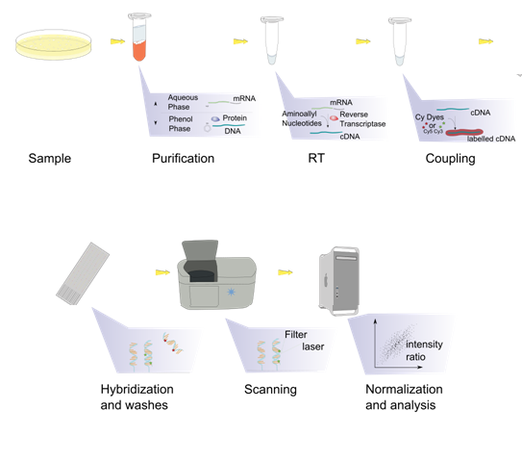
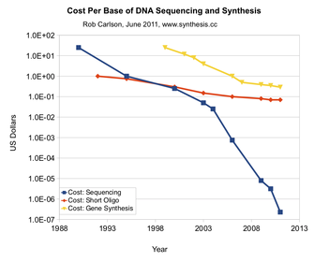
DNA MicroArrays

Slide 19
Issue-1: Are there strong correlations?
  Issue-1: Are there genes whose expression pattern are strongly correlated with the class distinction to be predicted?
Use Neighborhood Analysis
  Objective: To establish whether the observed correlations were stronger than would be expected by chance
  Defines an "idealized expression pattern" corresponding to a gene that is uniformly high in one class and uniformly low in the other
  Tests whether there is an unusually high density of genes "nearby" (or similar to) this idealized pattern, as compared to equivalent random patterns.
Why do we want to start with informative genes?
  To be readily applied in a clinical setting
  Highly instructive

Slide 20
Neighborhood Analysis
v(g) = (e₁, e₂, ..., e_{n})
c = (c₁, c₂, ..., c_{n})
Compute the correlation between v(g) and c.
  Euclidean distance
  Pearson correlation coefficient.
  P(g,c) = [µ₁(g) - µ₂(g)]/[ σ₁(g) + σ₂(g)]
V(g) = expression vector, with e_{i} denoting the expression level of gene g in ith sample
C=vector of idealized expression pattern. c_{i} = +1 or 0 based on i-th sample belonging to class 1 or 2
P(g,c) = Measure of Signal-to-noise ratio

Slide 21
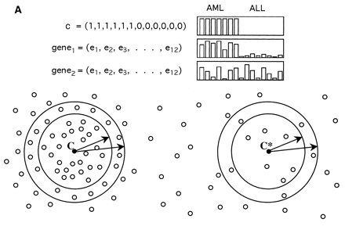
Neighborhood Analysis

Slide 22
Results of Neighborhood Analysis
Neighborhood Analysis showed that roughly 1100 genes of the 6,817 genes were more highly correlated with the AML-ALL class distinction than would be expected by chance
Suggested that classification could indeed be based on expression data.

Slide 23
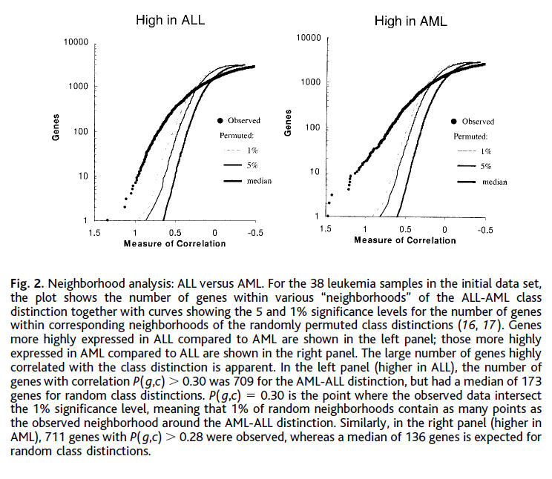
Results of Neighborhood Analysis

Slide 24
Issue-2: Building a Predictor
  Issue-2: How do we use a collection of known samples to create a “class predictor” capable of assigning a new sample to one of two classes?
Use a set of informative genes to build the predictor
They chose 50 genes most closely correlated with AML-ALL distinction in the known samples.
  Why 50? Why not 20 or 100?
  Predictors with 10 to 200 genes all gave 100% accurate classification
  50 seemed like a reasonably robust against noise but small enough to be readily applied in a clinical setting

Slide 25
Class Predictor via Gene Voting
Developed a procedure that uses a fixed subset of “informative genes”
Makes a prediction on basis of the expression level of these genes in a new sample
Each informative gene casts a “weighted vote” for one of the classes
The magnitude of each vote dependent on the expression level in the new sample and the degree of that gene's correlation with the class distinction
Votes were summed to determine the winning class
“Prediction Strength” (PS), a measure of the margin of victory that ranges from 0 to 1
The sample was assigned to the winning class if PS exceeded a predetermined threshold, and was otherwise considered uncertain.

Slide 26
Class Predictor via Gene Voting
Parameters (a_{g}, b_{g}) are defined for each informative gene
a_{g} = P(g,c)
b_{g} = [µ₁(g) + µ₂(g)]/2
v_{g} = a_{g}(x_{g} - b_{g})
V₁ = ∑ | V_{g} |; for V_{g} > 0
V₂ = ∑ | V_{g} |; for V_{g} < 0
PS = (V_{win} - V_{lose})/(V_{win} + V_{lose})
The sample was assigned to the winning class for PS > threshold.

Slide 27
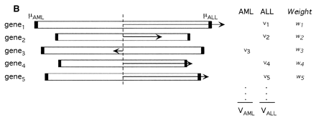
Class Predictor via Gene Voting

Slide 28
Issue-3: Validation of Class Predictors
  Issue-3: How do we test the validity of the class predictors?
Two-step validation:
  Cross-Validation (Leave-one-out)
  Independent Sample Validation

Slide 29
Results of Validation of Class Predictors
Initial Samples:
  36 of the 38 samples as either AML or ALL and two as uncertain
  All 36 samples agree with clinical diagnosis
Independent Samples:
  29 of 34 samples are strongly predicted with 100% accuracy
  Average PS was lower for samples from one lab that used a different protocol
  Should standardize of sample preparation in clinical implementation.

Slide 30
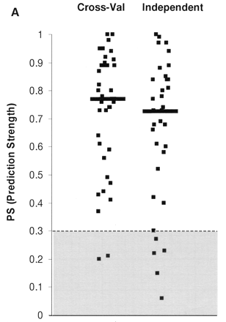
Validation of Class Predictors
Prediction Strengths were quite high:
Median PS = 0.77 in cross-validation
Media PS = 0.73 in independent test

Slide 31
A Look at the Set of 50 Genes
The list of informative genes used in the predictor was highly instructive
Some genes, including CD11c, CD33, and MB-1, encode cell surface proteins useful in distinguishing lymphoid from myeloid lineage cells.
Others provide new markers of acute leukemia subtype. For example, the leptin receptor, originally identified through its role in weight regulation, showed high relative expression in AML.
Together, these data suggest that genes useful for cancer class prediction may also provide insight into cancer pathogenesis and pharmacology.

Slide 32
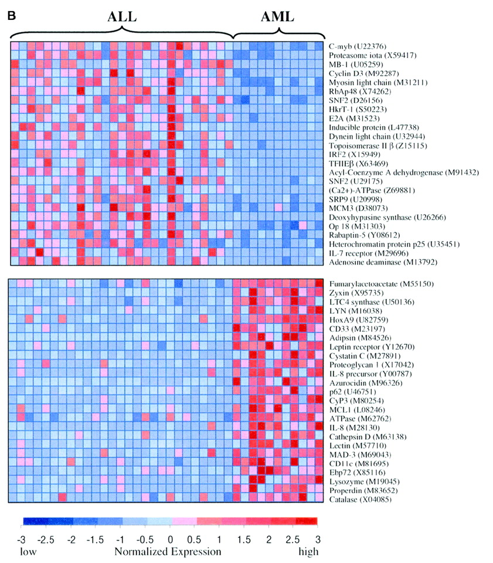

Slide 33
When Does This Methodology Work Best?
Can be applied to any measurable distinction among tumors
Importantly, such distinctions could concern a future clinical outcome
Ability to predict response to chemotherapy:
  Among the 15 adult AML patients who had been treated and for whom long-term clinical follow-up was available.
  No evidence of a strong multigene expression signature was correlated with clinical outcome (This could reflect the relatively small sample size).
  single most highly correlated gene out of the 6817 genes was the homeobox gene HOXA9, which was over-expressed in patients with treatment failure
  Further clinical trials needed to test the hypothesis that HOXA9 expression plays a role in predicting AML outcome.

Slide 34
Class Discovery
If the AML-ALL distinction was not already known, could it have been discovered simply based on gene expression?
Issues in Class Discovery:
  Cluster tumors based on Gene Expression
  Determining whether putative classes produced are meaningful i.e. whether they reflect true structure in the data rather than simply random aggregation.

Slide 35
Class Discovery
Clustering for class discovery (Unsupervised)
Self-organizing maps (SOMs) technique:
  User specifies the number of clusters to be identified.
  SOM finds an optimal set of "centroids" around which the data points appear to aggregate.
  It then partitions the data set, with each centroid defining a cluster consisting of the data points nearest to it.

Slide 36
Video on Clustering
K-Means Clustering: https://www.youtube.com/watch?v=_aWzGGNrcic
SOM:
https://www.youtube.com/watch?v=H9H6s-x-0YE

Slide 37
Self Organizing Map (SOM)
SOM is a mathematical cluster analysis for recognizing and classifying features in complex, multidimensional data (similar to K-mean approach)
    Chooses a geometry of “nodes”
    Nodes are mapped into K-dimensional space, initially at random
    Iteratively adjust the nodes
Adjusting the Nodes:
  Randomly select a data point P
  Move the nodes in the direction of P
  The closest node N_{p} is moved the most
  Other nodes are moved depending on their distance from N_{p} in the initial geometry

Slide 38
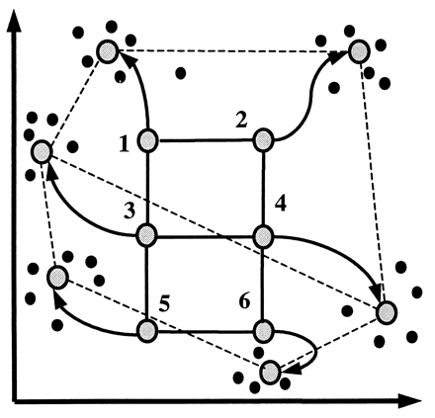
Self Organizing Map (SOM)

Slide 39
Results of Two-Cluster Analysis
Two-cluster SOM was applied to automatically group the 38 initial leukemia samples into two classes on the basis of the expression pattern of all 6817 genes.
Clusters were evaluated by comparing them to the known AML-ALL classes
  Class A1 contained mostly ALL (24 of 25 samples)
  Class A2 contained mostly AML (10 of 13 samples)
  SOM was thus quite effective at automatically discovering the two types of leukemia.

Slide 40
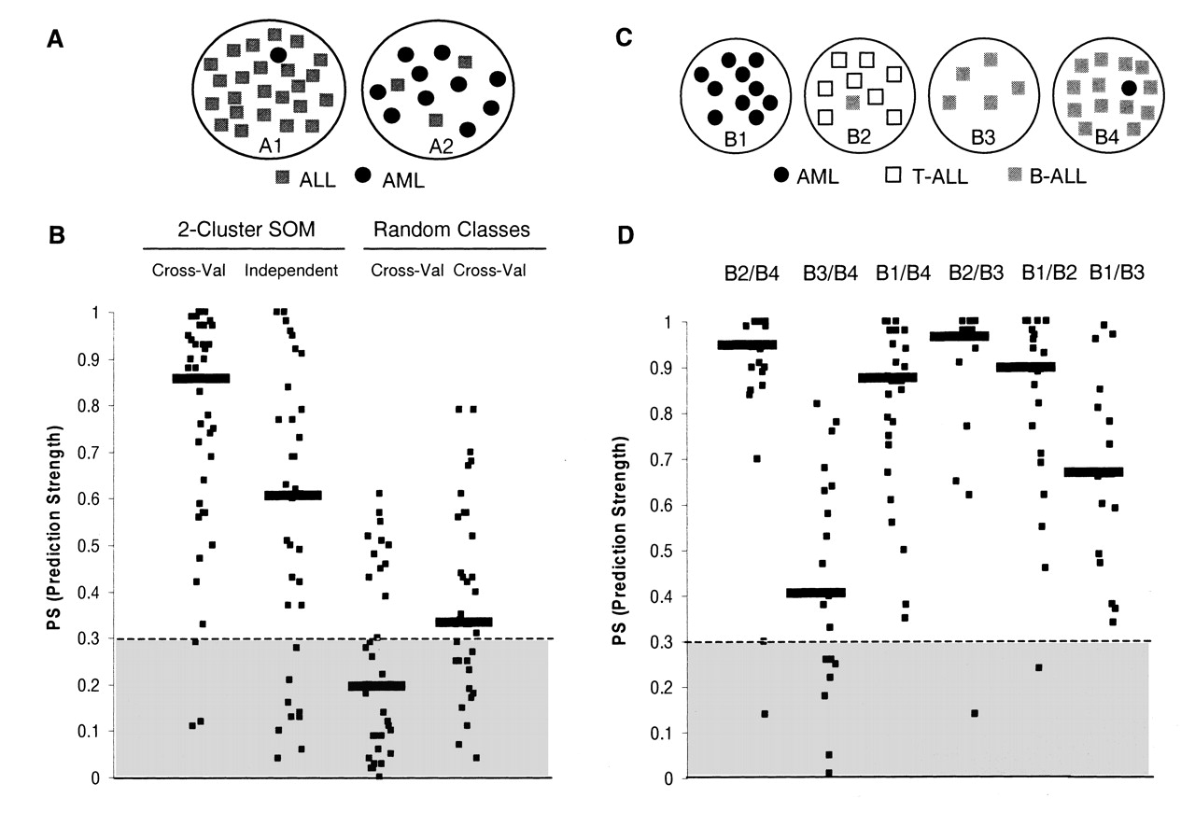

Slide 41
Discovering New Classes
Issue: How do we evaluate such putative clusters if the "right" answer were not already known?
Idea: Class discovery can be tested using Class Prediction
Intuition: If putative classes reflect true structure, then a class predictor based on these classes should perform well.
Discussion: Is this Reasonable? Is it possible that the putative classes perform well even if they do not reflect true structure?

Slide 42
Process & Results (Two Cluster)
Clusters A1 and A2 were evaluated:
  Constructed predictors to assign new samples as “Type A1" or “Type A2“
Cross-Validation:
  Predictors that used a wide range of different numbers of informative genes performed well
  Cross-validation thus not only showed high accuracy, but actually refined the SOM-defined classes except for the subset of samples accurately classified
  Similar analysis on random clusters yielded predictors with poor accuracy in cross-validation

Slide 43
Process & Results (Two Cluster)
Independent Set Validation:
  Median PS was 0.61, and 74% of samples were above threshold
  High PS indicates that the structure seen in the initial data set is also seen in the independent data set
  Predictors from random clusters consistently yielded low PS on independent data set
Conclusion:
  A1-A2 distinction can be seen to be meaningful, rather than simply a statistical artifact of the initial data set
  Results show that the AML-ALL distinction could have been automatically discovered and confirmed without previous biological knowledge

Slide 44
Process & Results (Four Cluster)
SOM divides the samples into four clusters
Largely corresponded to AML, T-lineage ALL, B-lineage ALL & B-lineage ALL
Four-cluster SOM thus divided the samples along another key biological distinction
Evaluated classes by constructing class predictors. The four classes could be distinguished from one another, with the exception of B3 versus B4
The prediction tests thus confirmed the distinctions corresponding to AML, B-ALL, and T-ALL
Suggested that it may be appropriate to merge classes B3 and B4, composed primarily of B-lineage ALL

Slide 46
Conclusion
Technique for creating class predictors
These class predictors could be adapted to a clinical setting, with appropriate steps to standardize the protocol for sample preparation.
Such a test supplementing rather than replacing existing leukemia diagnostics;
Class predictors can be constructed for known pathological categories and provide diagnostic confirmation or clarify unusual cases.
The technique of class prediction can be applied to distinctions relating to future clinical outcome, such as drug response or survival.
Class prediction provides an unbiased, general approach to constructing such prognostic tests.

Slide 47
Conclusion
In principle, the class discovery techniques discovered here can be used to identify fundamental subtypes of any cancer.
In general, such studies will require careful experimental design to avoid potential experimental artifacts--especially in the case of solid tumors.
Various approaches could be used to avoid such artifacts;
Class discovery methods could also be used to search for fundamental mechanisms that cut across distinct types of cancers.

Slide 48
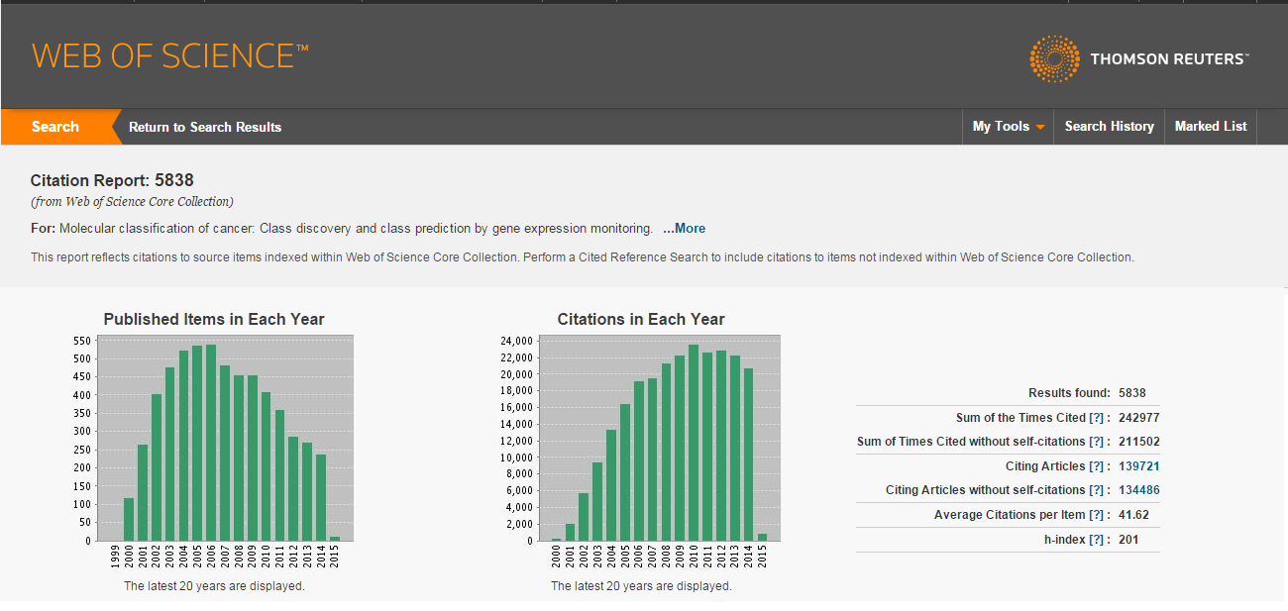
WOS Citation Report

Slide 49
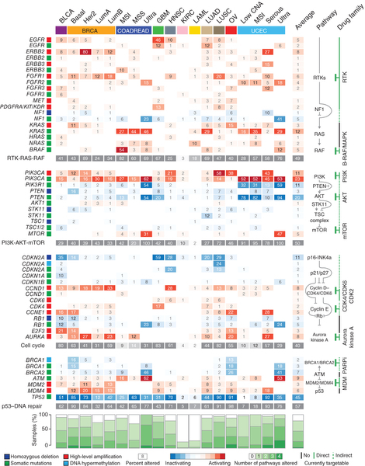
Mayo 50 Oncogene Panel

