Slide 1
Cancer hallmarks, “omic” data, and data resources
Anthony Gitter
Cancer Bioinformatics (BMI 826/CS 838)
January 22, 2015

Slide 2
What computational analysis contributes to cancer research
Predicting driver alterations
Defining properties of cancer (sub)types
Predicting prognosis and therapy
Integrating complementary data
Detecting affected pathways and processes
Explaining tumor heterogeneity
Detecting mutations and variants
Organizing, visualizing, and distributing data

Slide 3
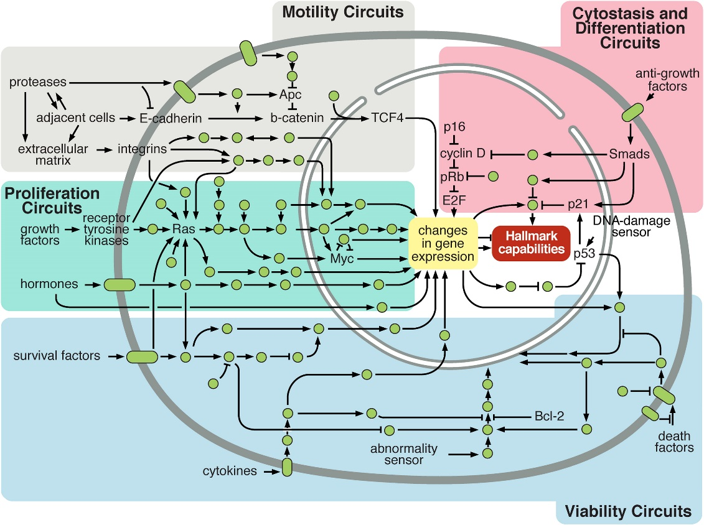
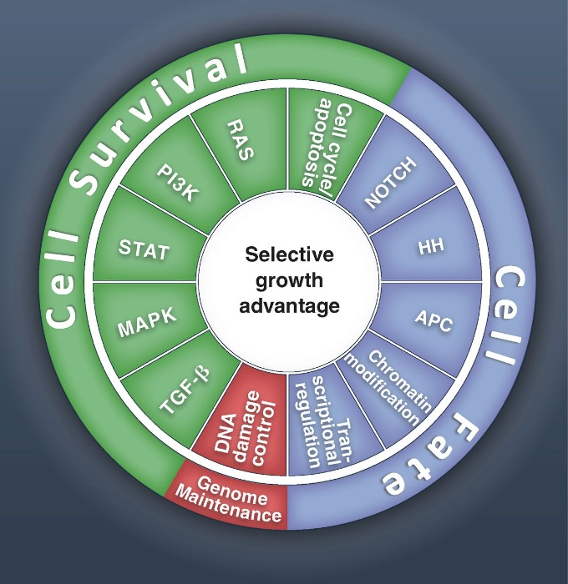
Convergence of driver events
Amid the complexity and heterogeneity, there is some order
Finite number of major pathways that are affected by drivers
  Vogelstein2013
  Hanahan2011

Slide 4
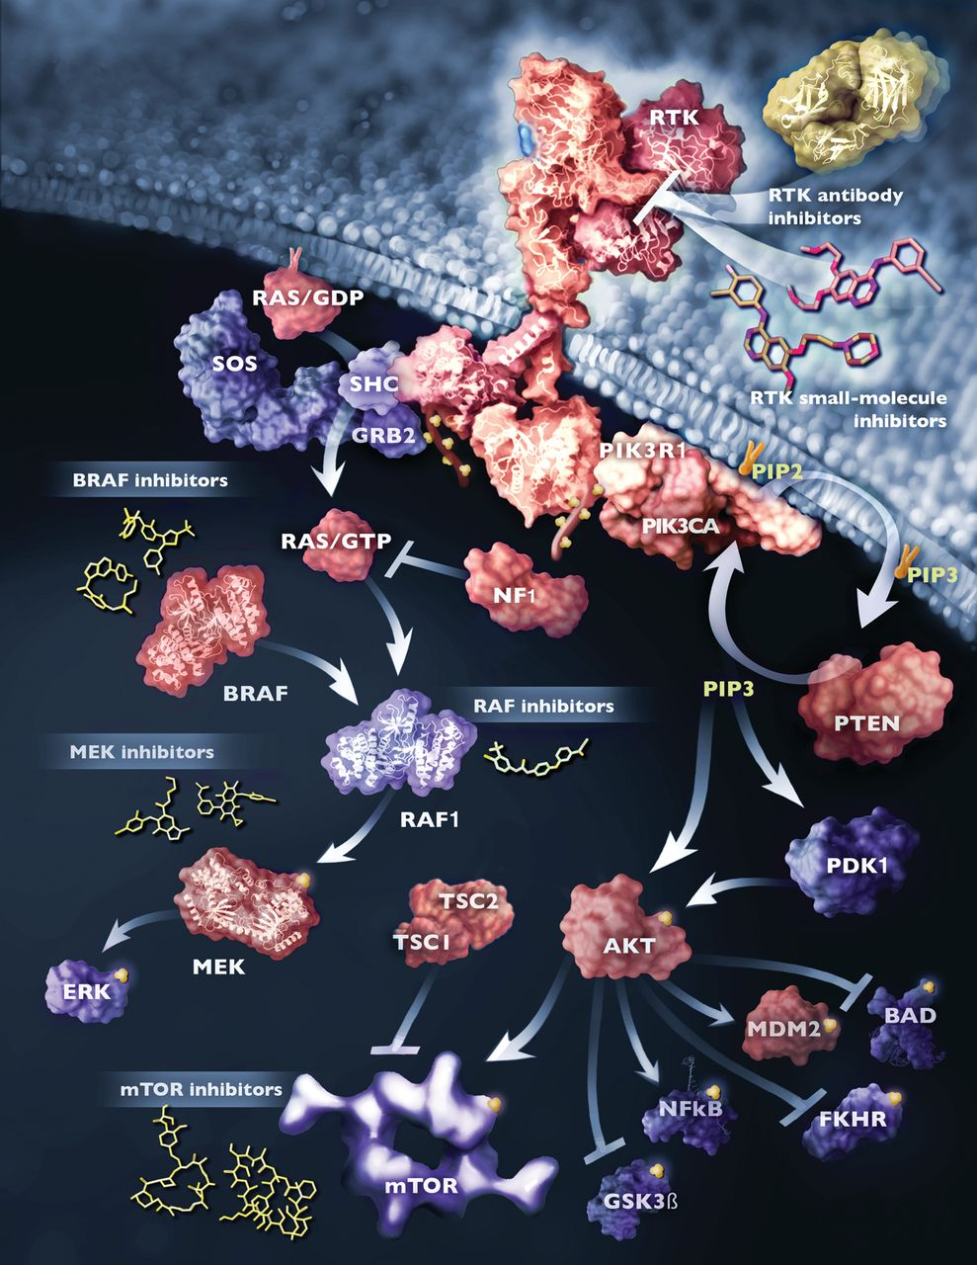
Similar pathway effects
Tumor 1: EGFR receptor mutation makes it hypersensitive
Tumor 2: KRAS hyperactive
Tumor 3: NF1 inactivated and no longer modulates KRAS
Tumor 4: BRAF over responsive to KRAS signals
  Vogelstein2013

Slide 5
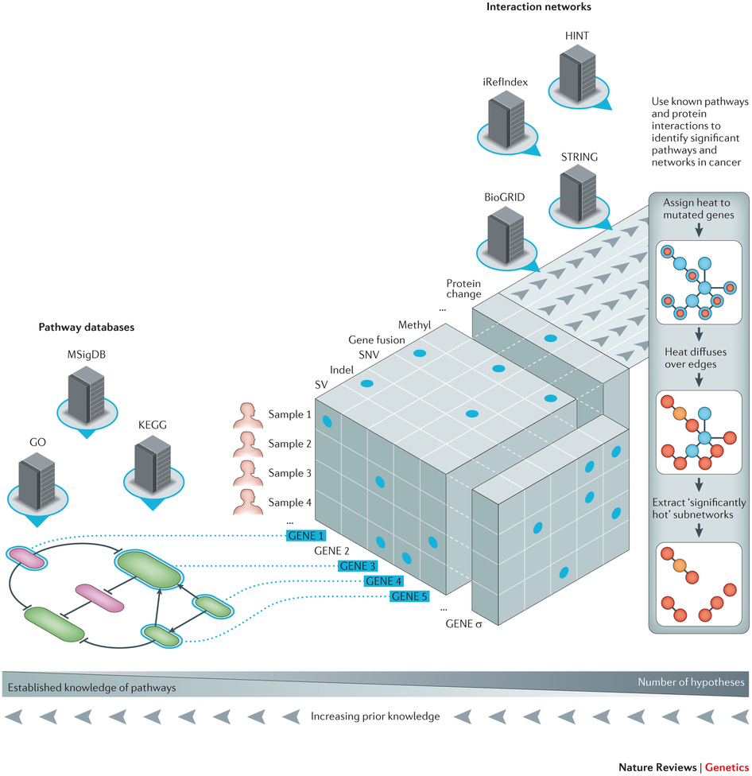
Detecting affected pathways
  Ding2014

Slide 6
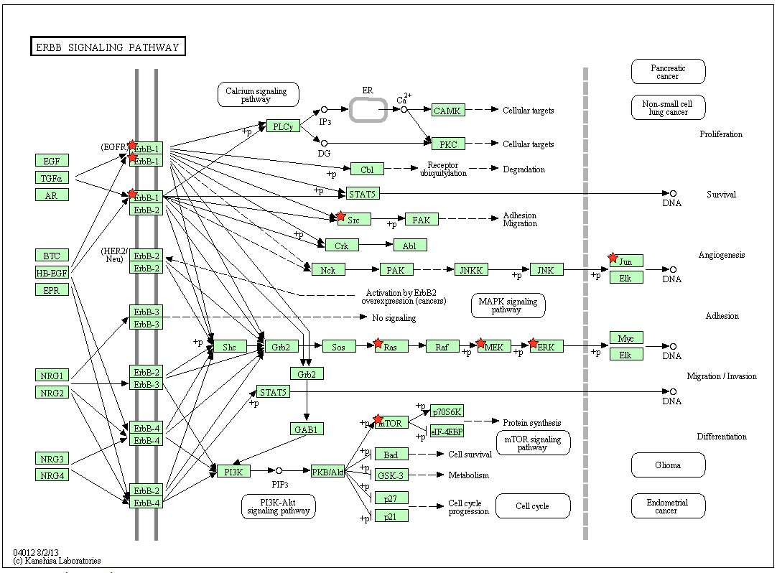
Pathway enrichment
  DAVID

Slide 7
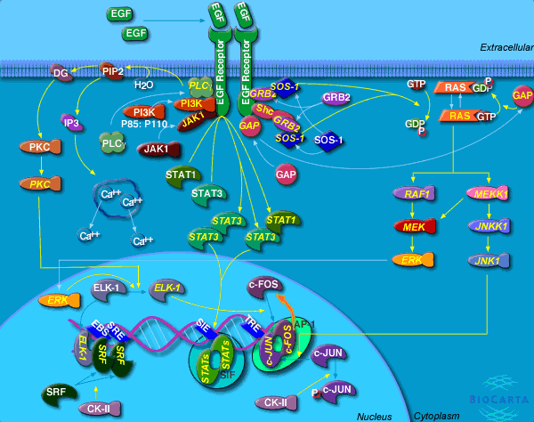
Pathway discovery
Stimulate receptor
31% of pathway
is activated
98% of activity
is not covered
BioCarta EGF Signaling Pathway
Phosphorylation data from Alejandro Wolf-Yadlin

Slide 8
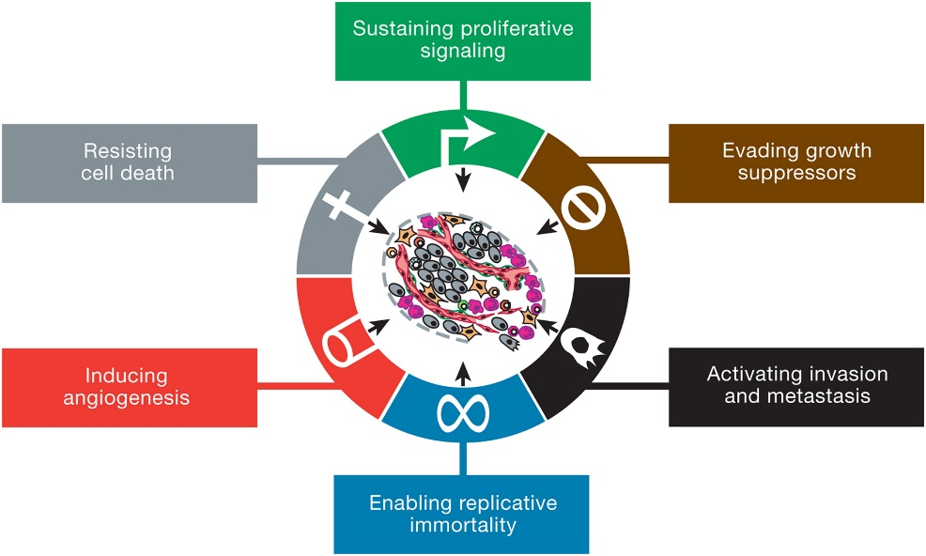
Hallmarks of cancer
  Hanahan2011

Slide 9
Sustaining proliferative signaling
Cells receive signals from the local environment telling them to grow (proliferate)
Specialized receptors detect these signals
Feedback in pathways carefully controls the response to these signals

Slide 10
Evading growth suppressors
Override tumor suppressor genes
Some proteins control the cell’s decision to grow or switch to an alternate track
  Apoptosis: programmed cell death
  Senescence: halt the cell cycle
External or internal signals can affect these decisions

Slide 11
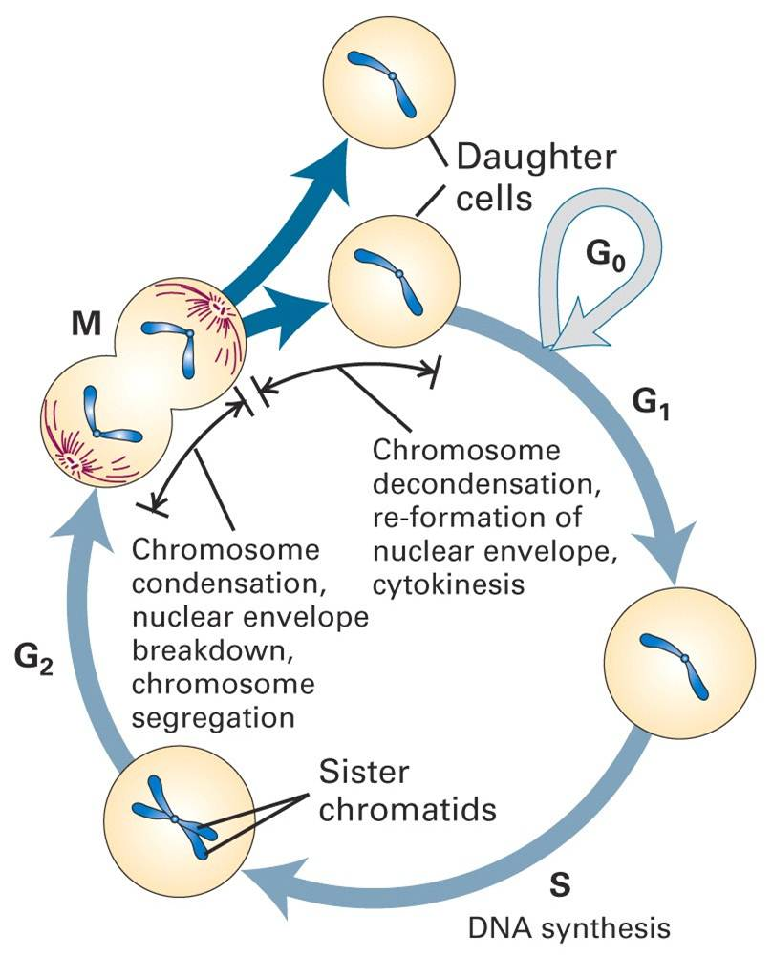
Cell cycle
Biology of Cancer

Slide 12
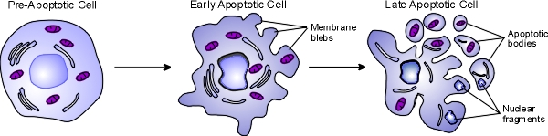
Resisting cell death
One self-defense mechanism against cancer
Apoptosis triggers include:
  DNA damage sensors
  Limited survival cues
  Overactive signaling proteins
Necrosis causes cells to explode
  Destroys a (pre)cancerous cell
  Releases chemicals that can promote growth in other cells
O’Day

Slide 13
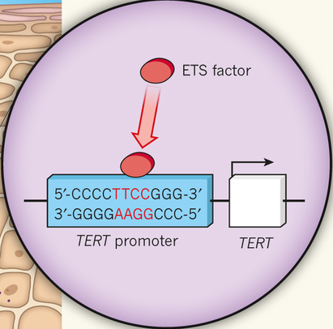
Enabling replicative immortality
Cells typically have a limited number of divisions
Immortalization: unlimited replicative potential
Telomeres protect the ends of DNA
  Shorten over time
  Encode the number of cell divisions remaining
  Can be artificially upregulated in cancer
Patton2013

Slide 14
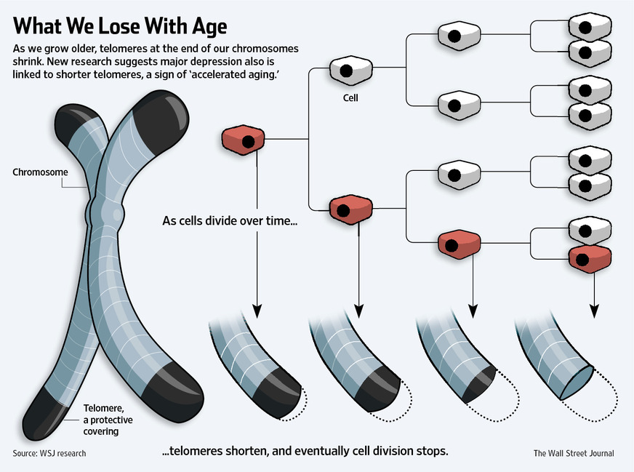
Telomere shortening
Wall Street Journal

Slide 15
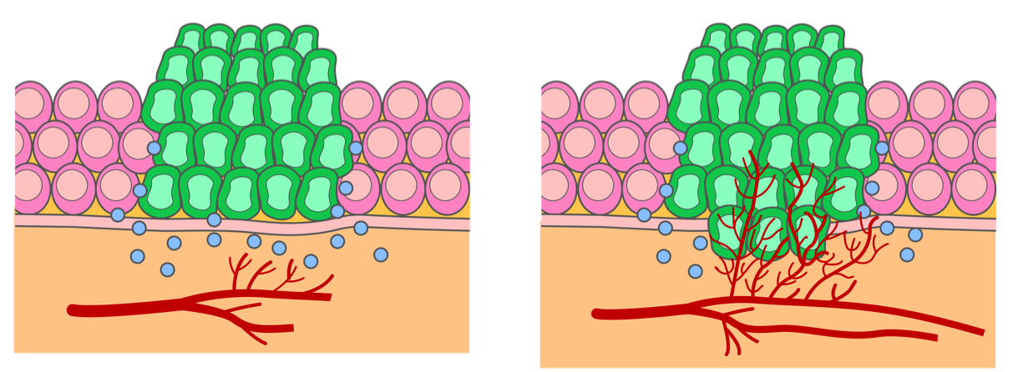
Inducing angiogenesis
Tumors must receive nutrients like other cells
Certain proteins promote growth of blood vessels
LKT Laboratories

Slide 16
Activating invasion and metastasis
Cancer progresses through the aforementioned stages
Epithelial-mesenchymal transition (EMT)

Slide 17
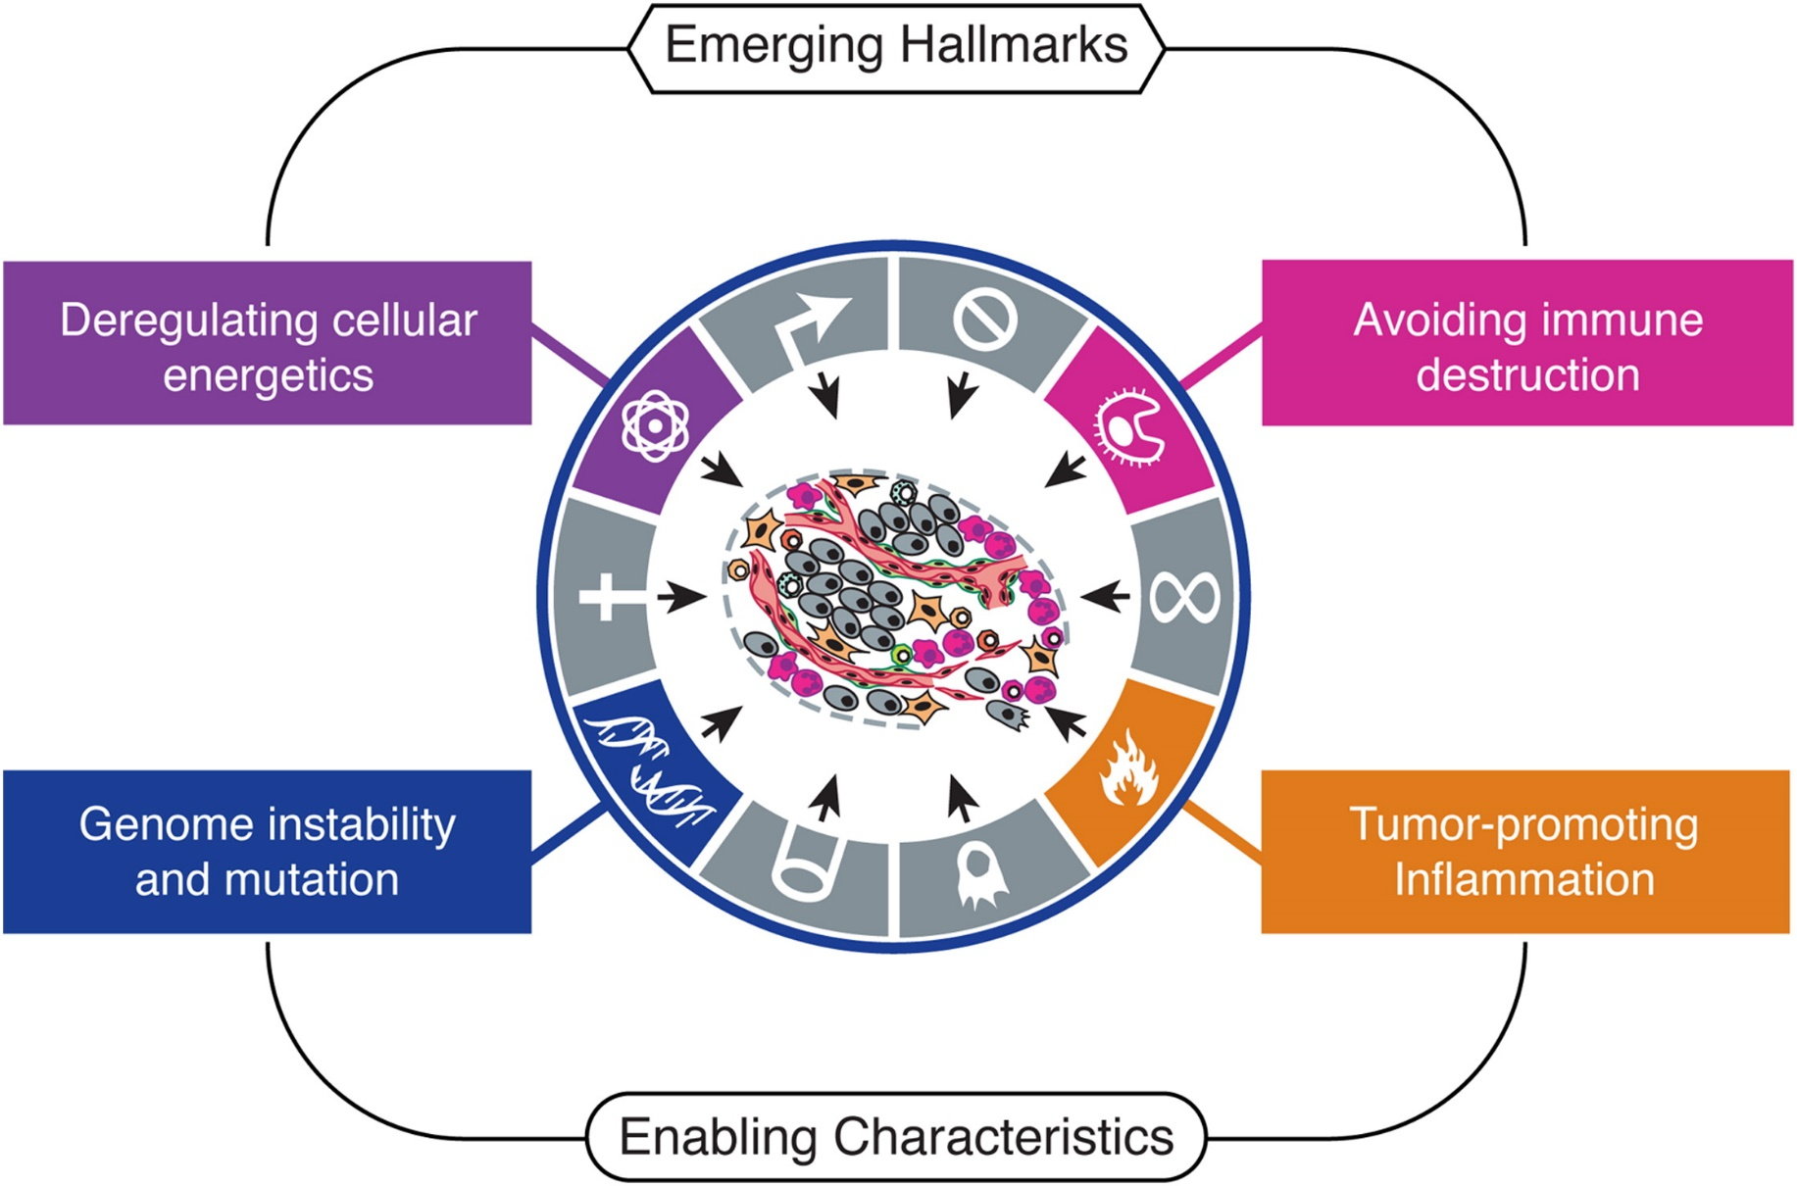
Emerging hallmarks
  Hanahan2011

Slide 18
Genome instability and mutation
Cancer cells mutate more frequently
Increased sensitivity to mutagens
Loss of telomeres increases copy number alterations

Slide 19
Model systems in oncology
Cell lines: Cells that reproduce in a lab indefinitely (e.g. Hela cells)
Genetically engineered mice: Manipulate mice to make them predisposed to cancer
Xenograft: Implant human tumor cells into mice

Slide 20
“Omic” data types
DNA (genome)
  Mutations
  Copy number variation
  Other structural variation
RNA expression (transcriptome)
  Gene expression (mRNA)
  Micro RNA expression (miRNA)
Protein (proteome)
  Protein abundance
  Protein state (e.g. phosphorylation)
Protein DNA binding
DNA state and accessibility (epigenome)
  DNA methylation (methylome)
  Histone modification / chromatin marks
  DNase I hypersensitivity

Slide 21
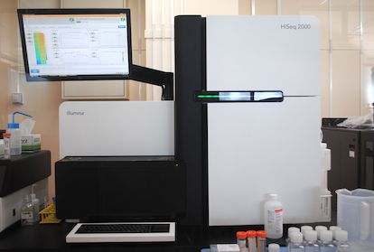
“Next-generation” sequencing (NGS)
Revolutionized high-throughput data collection
*-seq strategy
  Decide what you want to measure in cells
  Figure out how to select or synthesize the right DNA
  Dump it into a DNA sequencer
~100 different *-seq applications
NODAI

Slide 22
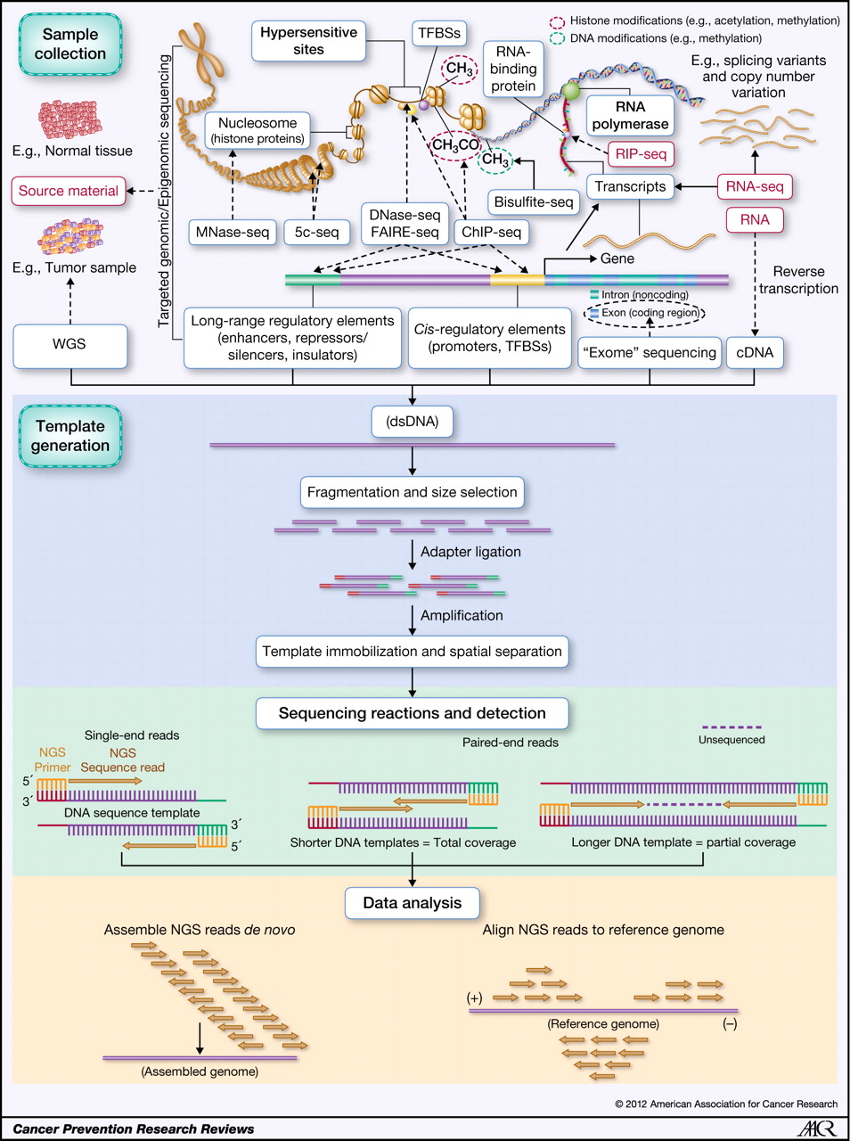
*-seq examples
Rizzo2012

Slide 23
Generating DNA templates
Rizzo2012

Slide 24
Generating reads
Rizzo2012

Slide 25
Assembly and alignment
Rizzo2012

Slide 26
Microarrays
High-throughput measurement of gene expression, protein DNA binding, etc.
Mostly replaced by *-seq
Fixed probes as opposed to DNA reads

Slide 27
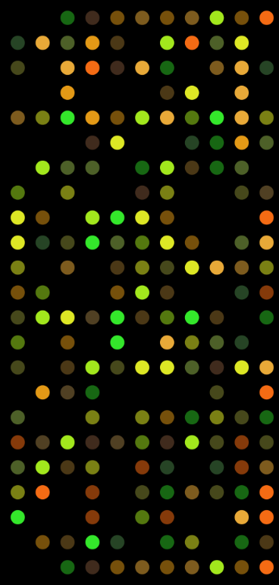
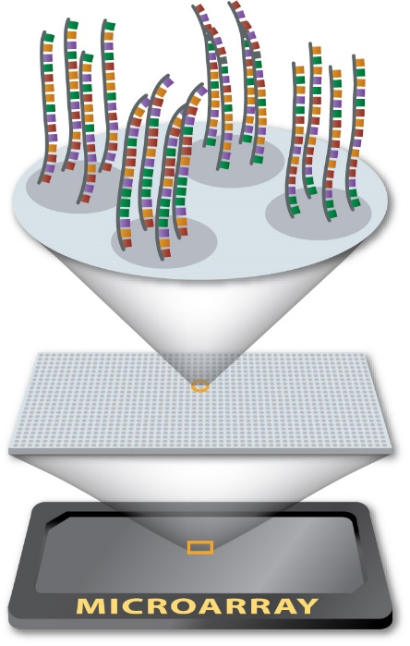
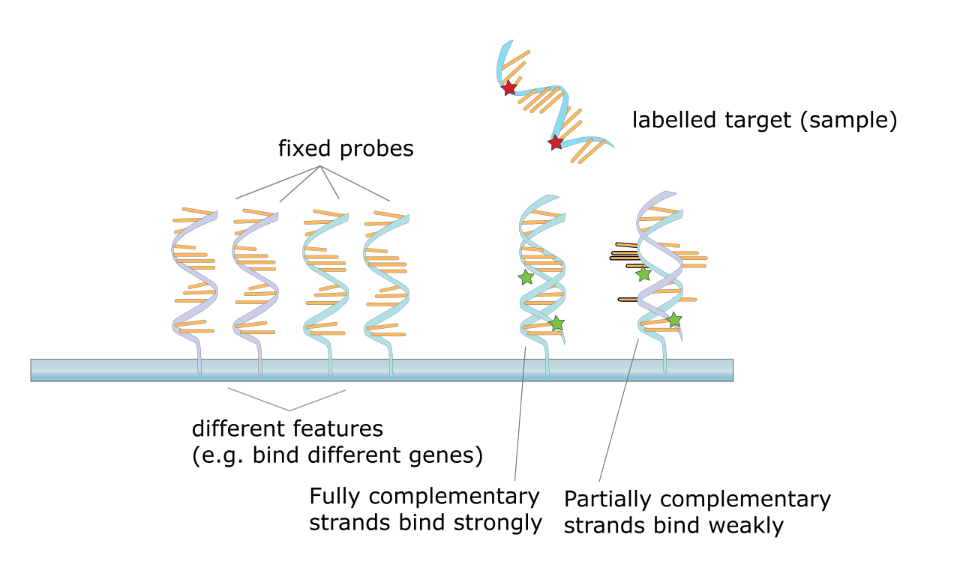
Microarray quantification
University of Utah
Wikipedia
Wikimedia

Slide 28
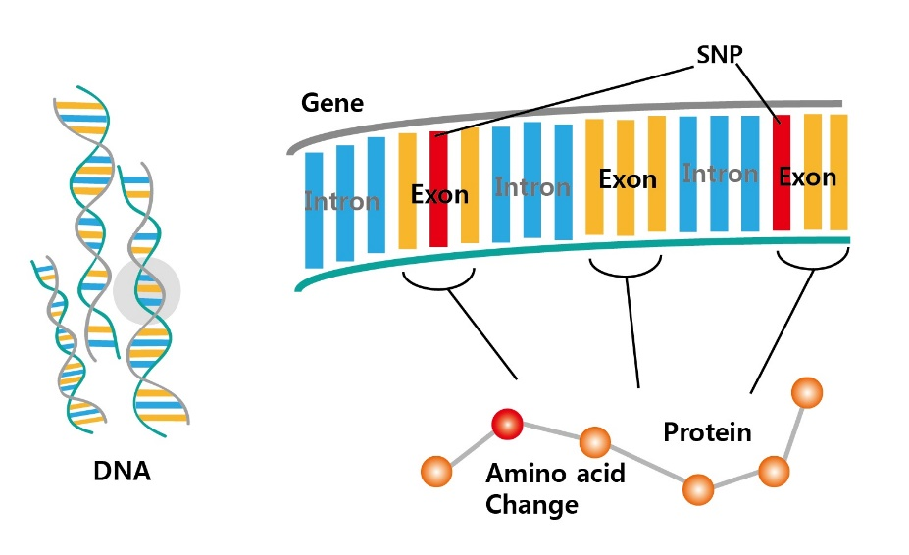
DNA mutations
Whole-exome most prevalent in cancer
  Only covers exons that form genes, less expensive
Whole-genome becoming more widespread as sequencing costs continue to decrease
DNA Link

Slide 29
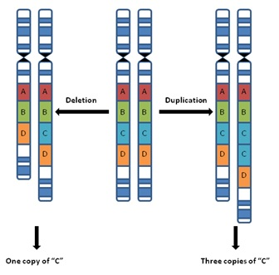
Copy number variation
Often represented as relative to normal 2 copies
Ranges from a few bases to whole chromosomes
Quantitative, not discrete, representation
MindSpec

Slide 30
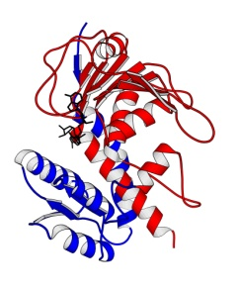
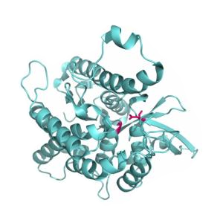
Gene expression
Transcript (messenger RNA) abundance
Appling lab
Graz

Slide 31
Genome-wide gene expression
Quantitative state of the cell
Gene 1
1
35
…
…
5
15
32
…
…
0
87
2
…
…
65
85
2
…
…
3
Gene 2
Gene
20000
Brain
Heart
Blood (normal)
Blood (infected)

Slide 32
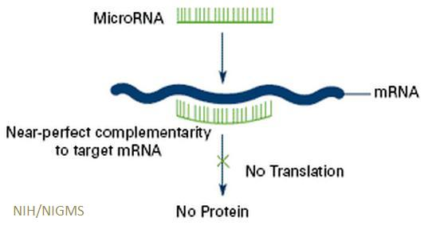
miRNA expression
microRNA (miRNA)
  ~22 nucleotides
  Does not code for a protein
  Regulates gene expression levels by binding mRNA
NIH

Slide 33
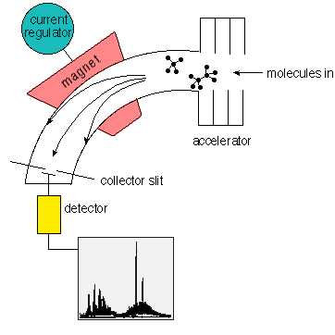
Protein abundance
Protein abundance is analogous to gene expression
Not perfectly correlated with gene expression
Harder to measure
Mass spectrometry is almost proteome-wide
  Vaporize molecules
  Determine what was vaporized
  based on mass/charge
David Darling

Slide 34
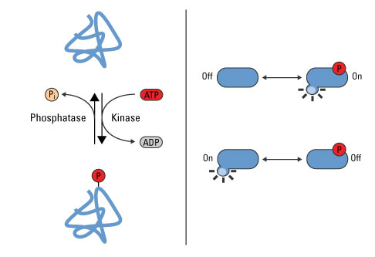
Protein state
Chemical groups added to mature protein
Phosphorylation is the most-studied
Analogous to Boolean state
Pierce

Slide 35
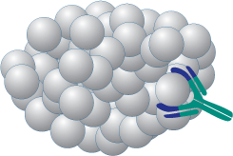
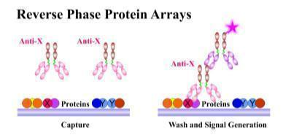
Protein arrays
Currently more common in cancer datasets
Measure a limited number of specific proteins using antibodies
Protein abundance or state
R&D
MD Anderson

Slide 36
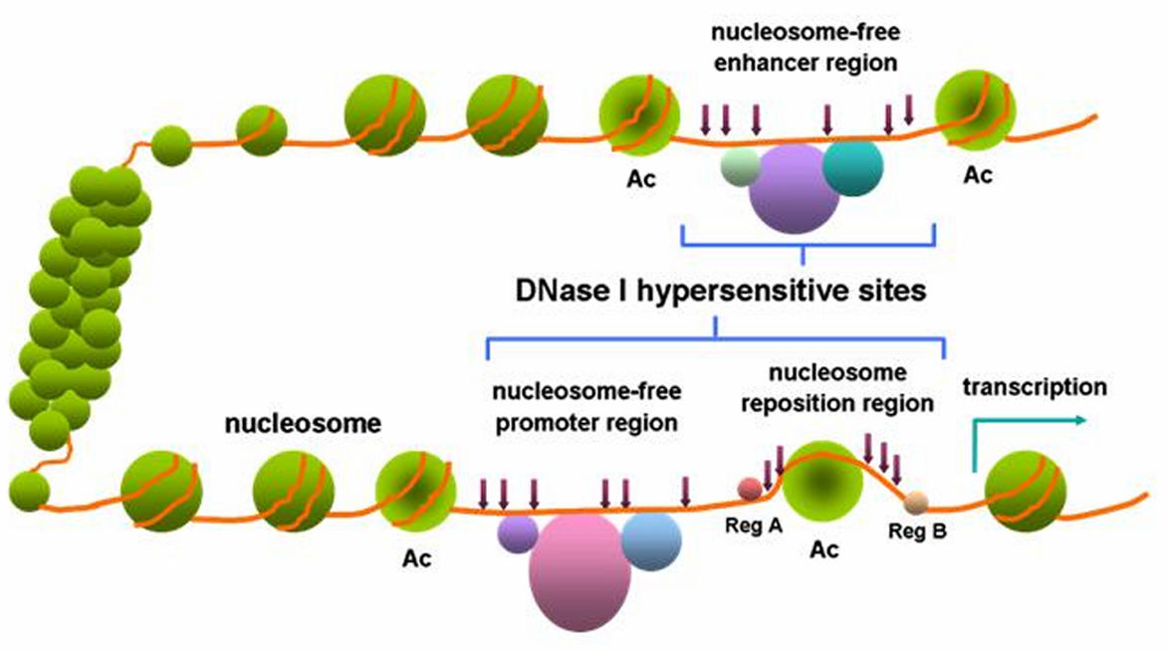
Transcriptional regulation
ChIP-seq directly measures transcription factor (TF) binding but requires a matching antibody
Various indirect strategies
Wang2012

Slide 37
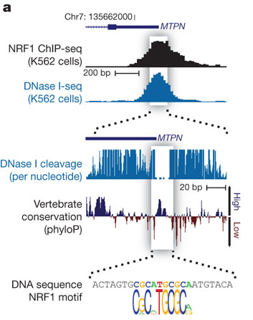
Predicting regulator binding sites
Motifs are signatures of the DNA sequence recognized by a TF
TFs block DNA cleavage
Combining accessible DNA and DNA motifs produces binding predictions for hundreds of TFs
Neph2012

Slide 38
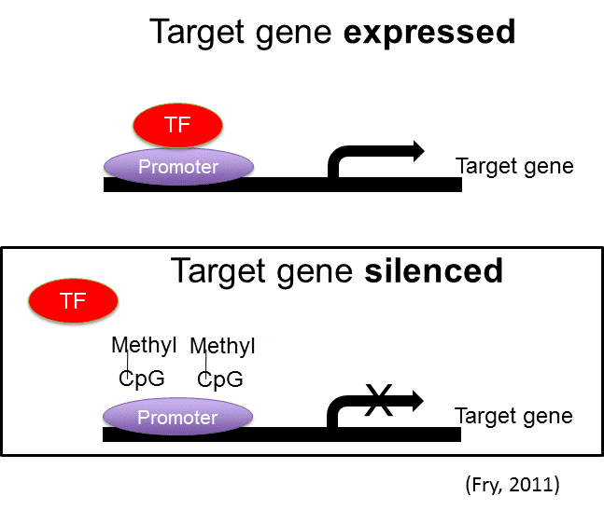
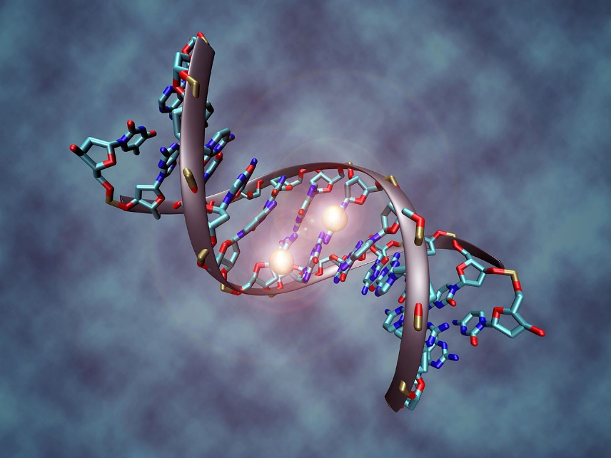
DNA methylation
Methylation is a DNA modification (state change)
Hyper-methylation suppresses transcription
Methylation almost always at C
Wikimedia
Learn NC

Slide 39
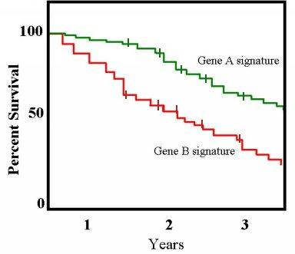
Clinical data
Age, sex, cancer stage, survival
Kaplan–Meier plot
Wikipedia

Slide 40
Large cancer datasets
Tumors
  The Cancer Genome Atlas (TCGA)
  Broad Firehose and FireBrowse access to TCGA data
  International Cancer Genome Consortium (ICGC)
Cell lines
  Cancer Cell Line Encyclopedia (CCLE)
  Catalogue of Somatic Mutations in Cancer (COSMIC)
Cancer gene lists
  COSMIC Gene Census
  Vogelstein2013 drivers

Slide 41
Interactive tools for cancer data
cBioPortal
TumorPortal
Cancer Regulome
Cancer Genomics Browser
StratomeX

Slide 42
Gene and protein information
TP53 example
  GeneCards
  UniProt
  Entrez Gene

Slide 43
Pathway and function enrichment
Database for Annotation, Visualization and Integrated Discovery (DAVID)
Molecular Signatures Database (MSigDB)

Slide 44
Gene expression data
Gene Expression Omnibus (GEO)
ArrayExpress

Slide 45
Protein interaction networks
iRefIndex and iRefWeb
Search Tool for the Retrieval of Interacting Genes/Proteins (STRING)
High-quality INTeractomes (HINT)

Slide 46
Transcriptional regulation
Encyclopedia of DNA Elements (ENCODE)
DNA binding motifs
  TRANSFAC
  JASPAR
  UniPROBE

Slide 47
miRNA binding
miRBase
TargetScan

