Slide 1
HotNet

Slide 2
Background
Determine significantly mutated subnetworks in a large gene interaction network
Problems with current methods
  Frequency doesn’t always predict significance
  Naïve subnetwork analysis
    Enumeration prohibits subnetworks of reasonable size
    Large number of hypotheses makes statistically significant difficult
    Hub genes make for small gene diameters
Notes:
Many times researchers will look at the frequency of genes in a myriad of tumors from different samples; however, many genes don’t have a high frequency

Slide 3
HotNet Overview
Formulate an influence measure between pairs of genes in the network
Identify subnetworks with Combinatorial Model or Enhanced Influence Model
Two-stage multiple hypothesis test to mitigate testing of large number of hypotheses
Notes:
Influence graph – one gene to influence another if they are close in distance and ther are relatively few paths between them

Slide 4
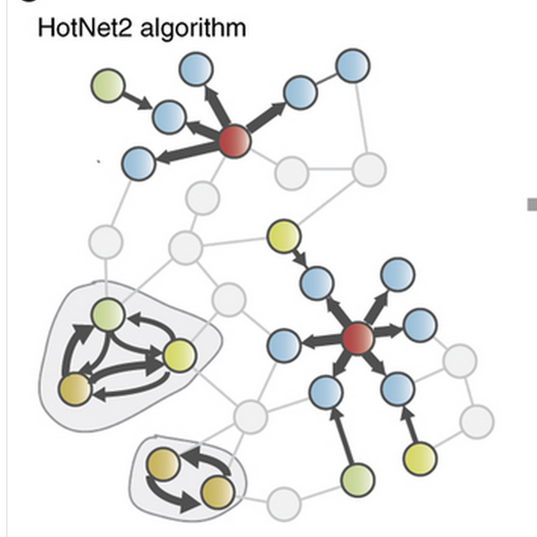
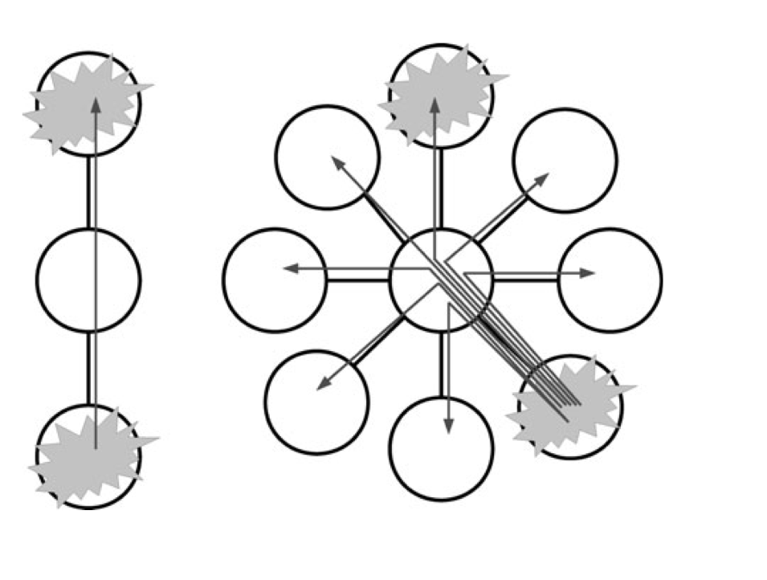
Influence Graph
Identify subnetworks that are significant with respect to a set of mutated genes
Notes:
Significance from the number of samples that have mutations in the genes of the subnetwork
And
The interactions between genes in the subnetwork in the context of the topology of the whole network
To do this, take into account that two genes are close in distance and have low degree

Slide 5
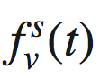
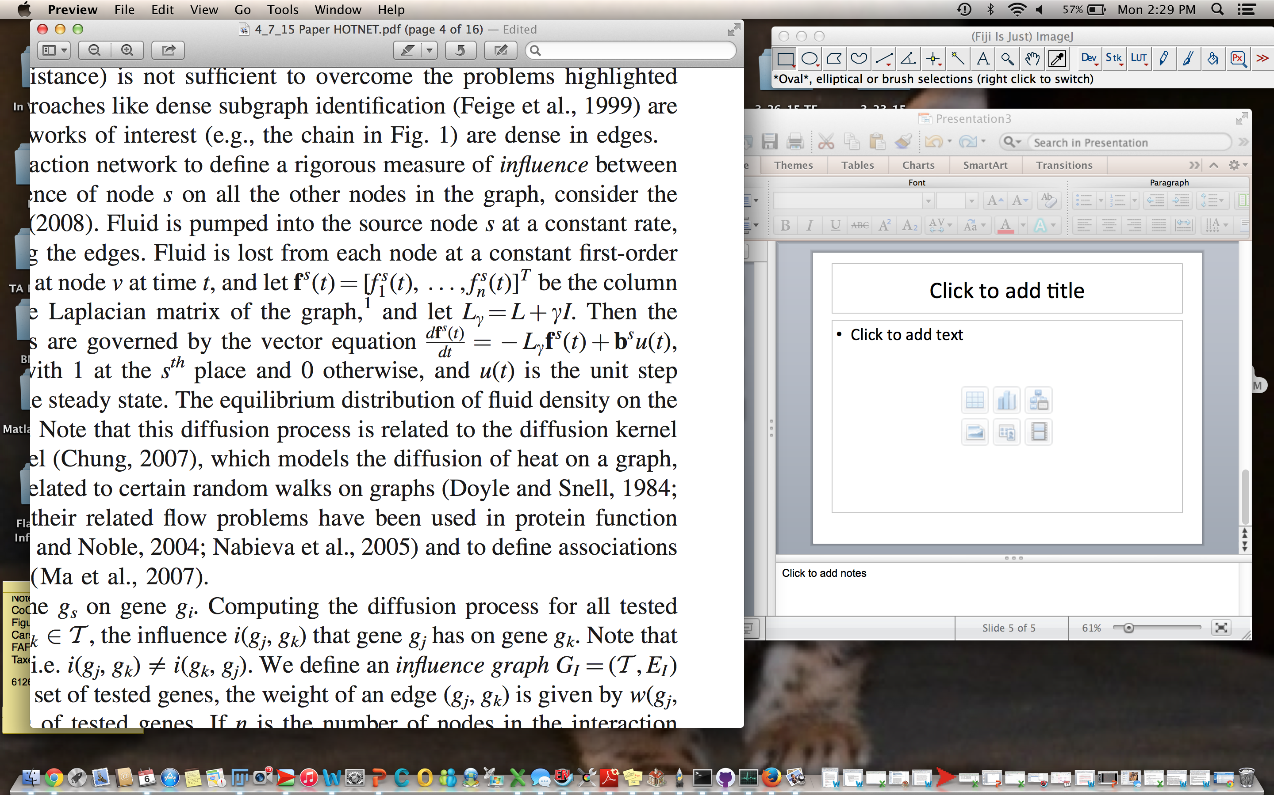
Diffusion
Amount of fluid @ node V at time T
Amount of fluid at all nodes
L is the laplacian matrix of the graph
Dynamics of the continuous process
Interpret f_{i} as the influence of gene g_{s} on g_{i}

Slide 6
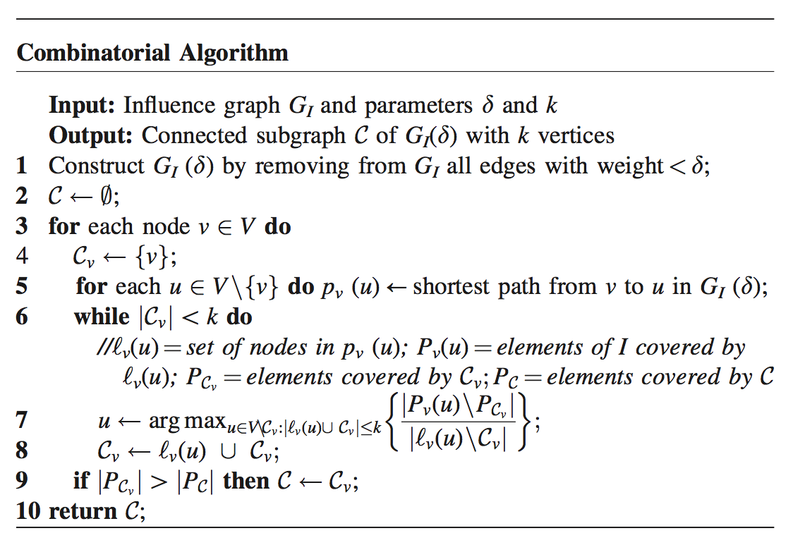
Combinatorial Model
Takes in influence measure between genes to discover significant subnetworks
Notes:
Identify sets of nodes in the influence graph G that are connected through edges with high influence and correpsond to mutated genes in a signifcant number of samples

Slide 7
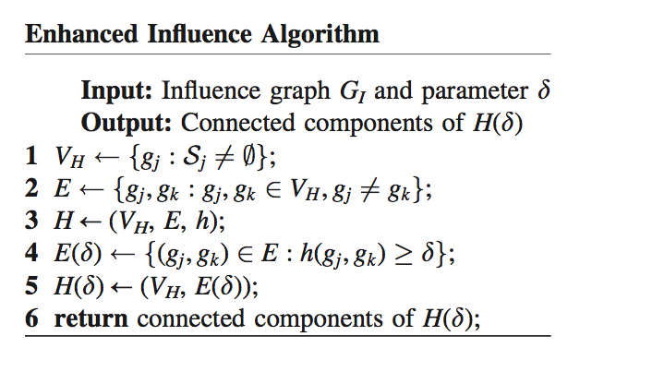
Enhanced Influence Model
Enhance the influence measure between genes by the number of mutations observed in each gene
Notes:
Assign vertices of H by all genes with at least on mutation in the data
Ensure gj and gj are part of VH and not equal
Create H
Reduce H with threshold

Slide 8
Statistics
Calibrates with H_{o}^{sample} and H₀^{gene}
  Sample: mutations placed at random nodes
  Gene: Move genes around…..?
Compute significance of number of subnetworks
Bound FDR

Slide 9
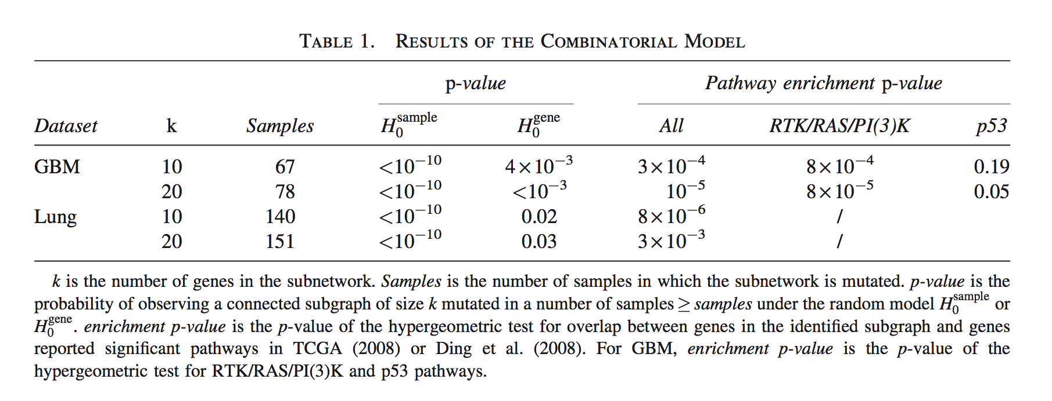
Experimental Data
Notes:
Find Statistically significant subnetworks for both null hypotheses

Slide 10
